Slide 1

SALES FORECASTING AND DEMAND PREDICTION
Presenters:
Adel Madgy
Mohamed Ismail
Khaled Mohey Elden
Mohamed Hany

Slide 2


01 PROJECT IDEA
The objective aims to build a machine learning model that predicts future sales and demand for products based on historical data.
We are using XGBoost for forecasting and a Dash dashboard for visualization.

Slide 3
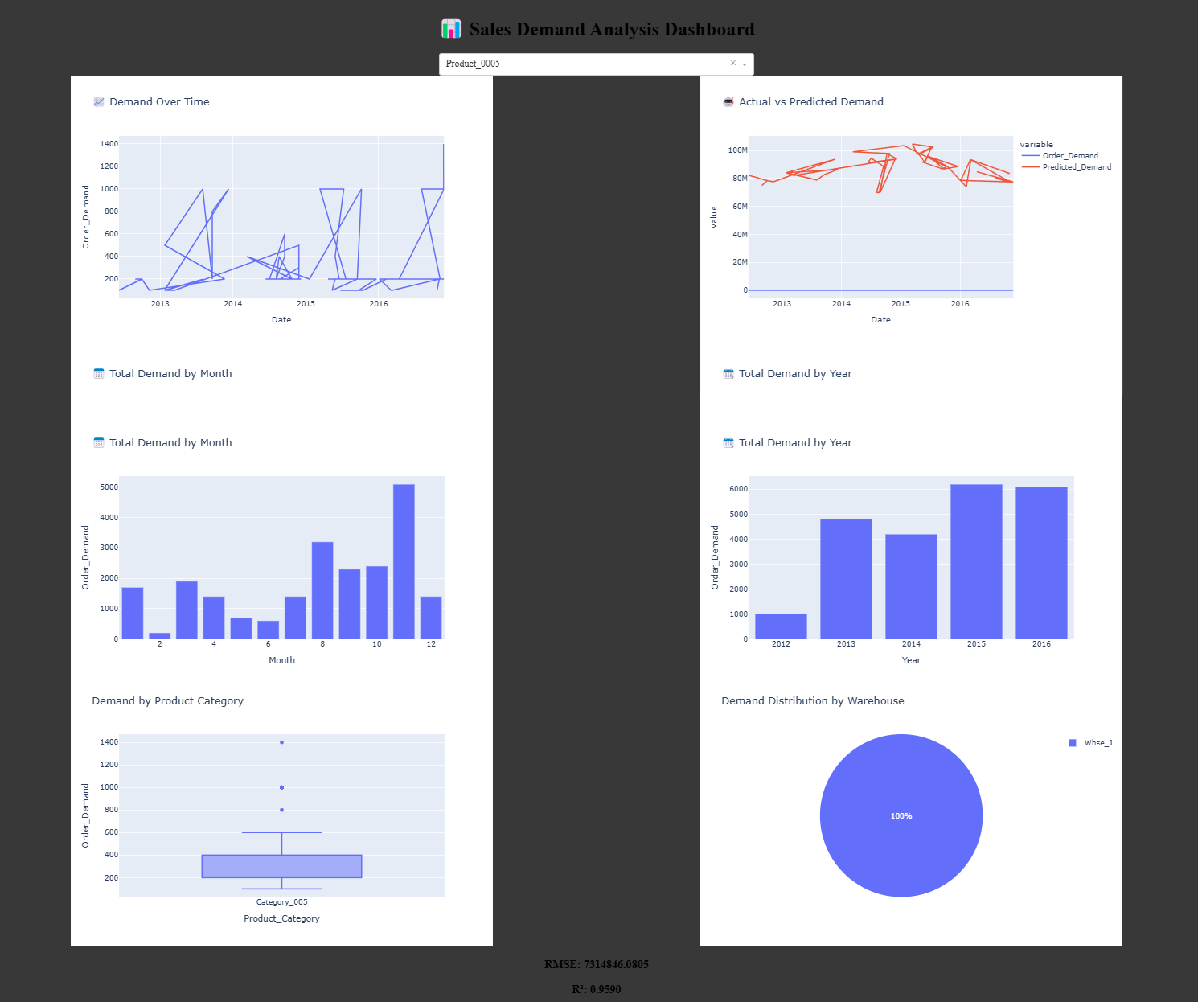
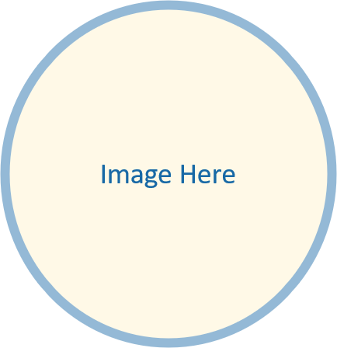
02 PROJECT WIREFRAME User Journey: 1- Select product. 2-View demand trends, actual vs. predicted, and forecast.

Slide 4
03 END USERS & FEATURES
Users
Retail Managers
Supply Chain Planners
Key Features
Demand visualization
Predicted vs Actual comparison
Future sales forecast
User Value
Optimize stock and reduce shortages/overstock.

Slide 5
04 DATA STRUCTURE
Dataset Name: Historical Product Demand
Total Records: 1,048,575
Columns:
Product Code (2160 unique values)
Warehouse (4 unique values)
Product Category (33 unique values)
Date (Some missing values: 11,239)
Order Demand (Contains non-numeric characters)

Slide 6
05 DATA PREPROCESSING
Typecasting
Convert Date to date/ time format and drop NA values
Typecasting
Order-Demand Cleaning
Remove non-numeric characters
Convert to numeric
Drop missing and zero/negative values
Feature Engineering
Year
Month
Day
Weekday
Lag and rolling features

Slide 7
06 PROGRAMMING LANGUAGES
Languages
Python
Frameworks
RandomForest
Mlflow
Flask
Dash
Plotly
XGBoost
Supporting
Joblib for model storage

Slide 8
07 DATA VISUALIZATION

Slide 9
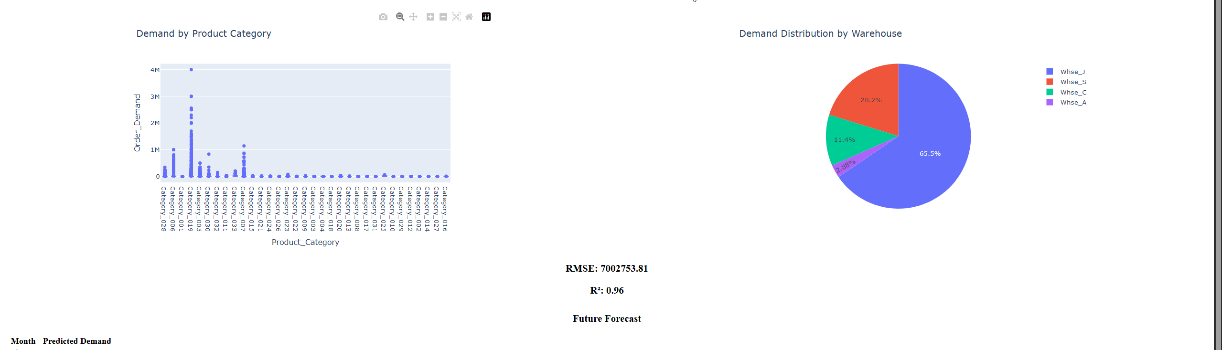

Slide 10
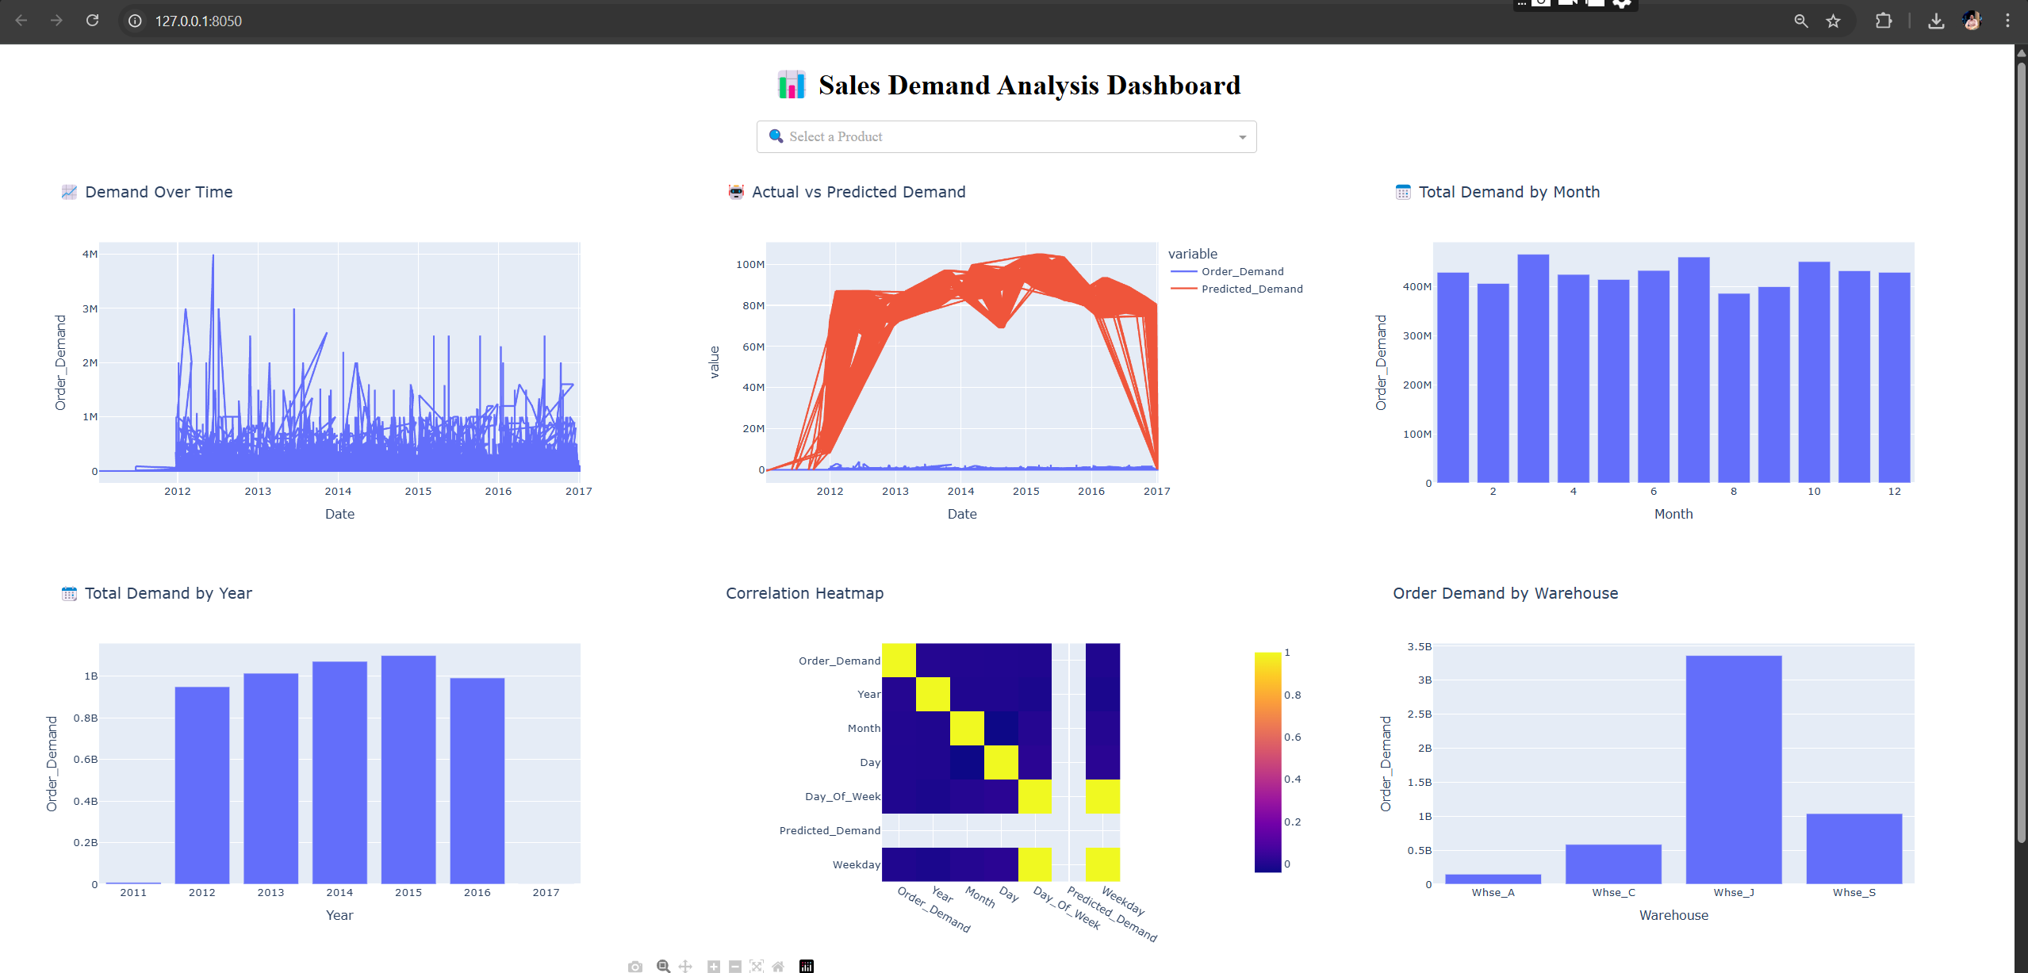
dashboard

Slide 11
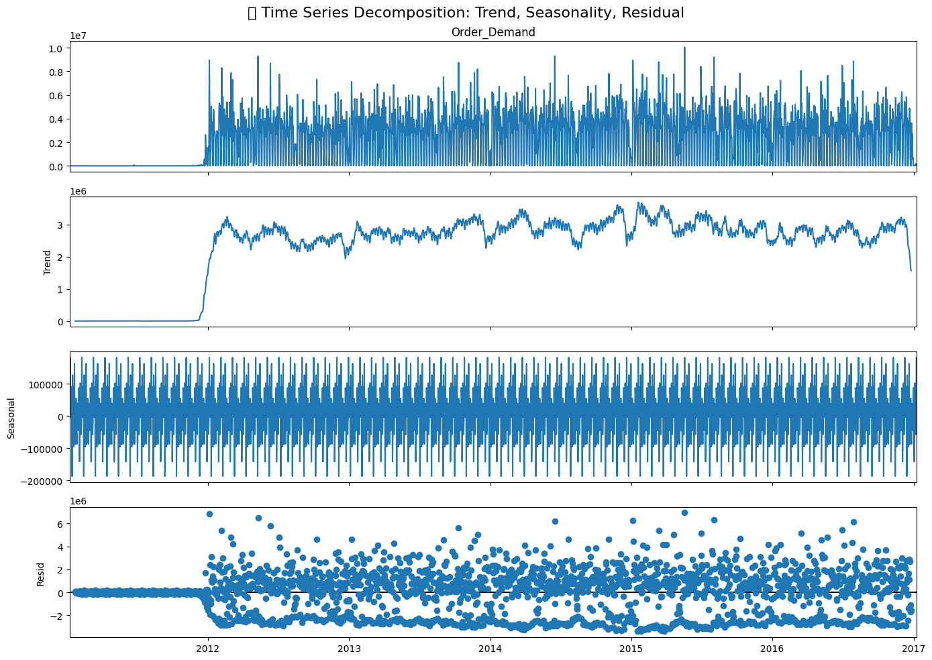
Timeseries Analysis Decomposition

Slide 12
08 MACHINE LEARNING
parameter | XGBoost | RandomForest
RMSE | 6659709.63 | 7314846.08
R2 | 0.97 | 0.96
Custom Success Rate | 64.29% | 64.29

Slide 13
DELIVERABLES
report containing project details including procedure, techniques, and results.
PowerPoint presentation
Github link to the project files and the python code Project Link: KhaledMoheyD/Sales-Forecasting-and-Demand-Prediction: This is a team project in data science track in Digital Egypt Pioneers Initiative

Slide 14
Team Members
Team Member | Role
Mohamed Ismail (Team Leader) | Feature engineering, and model training
Khaled Mohey | Data Exploration, analysis
Adel Magdy | Model Selection and evaluation
Ahmed Hassan | MLops and model deployment
Youssef Adel | hyperparameter tuning
Mohamed Hany | Data Visualization

